Slide 1
The NDMP and the NDD Entering data online and completing the forms
People’s Trust for Endangered Species, 3 Cloisters House, 8 Battersea Park Road, London SW84BG
Registered charity no 274206
Notes:
Here with 3 hats
SSCG
PTES (later what I do for them)
HDP (later)
Here to talk about dormice but if you do have them how lucky are you?
Quick overview of dormice in Britain
Dormouse ecology
Habitat management
Finally national and local dormouse monitoring
Take Longworth
Temp trap
Nests
Nuts

Slide 2
The National Dormouse Monitoring Programme (NDMP)
50 boxes in a site with dormice
Approximately 20m apart
Check minimum of twice a year in May/June and Sept/October
Check between 15th and 25th of month
Record number or dormice and basic biometric data
Submit results annually to PTES

Slide 3
The National Dormouse Database (NDD)
Dormouse records for sites not in the NDMP
Record who, what, where, when
Ideally photographic record
Data exchanged with local record centres

Slide 4
www.ptes.org/dormousemonitoring

Slide 5
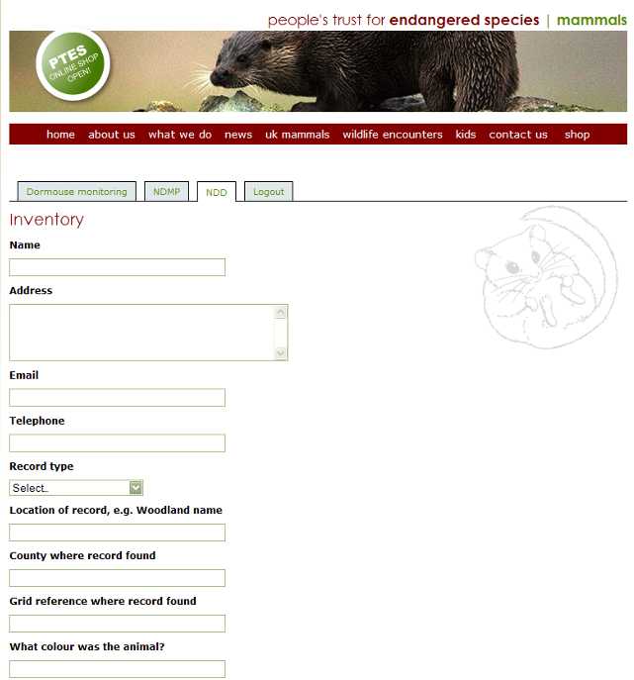
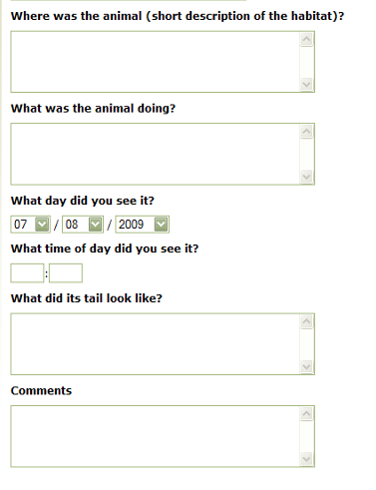

Slide 6
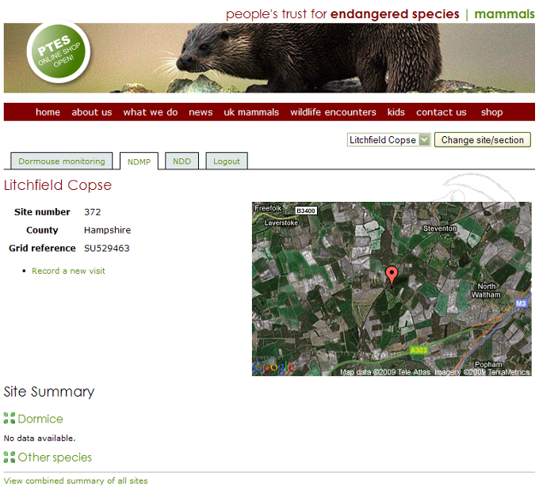

Slide 9
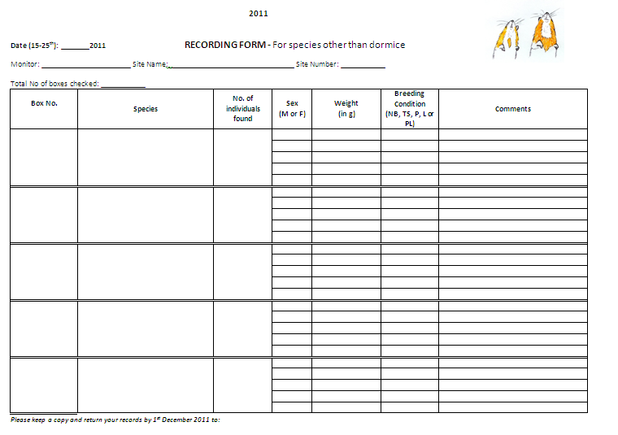
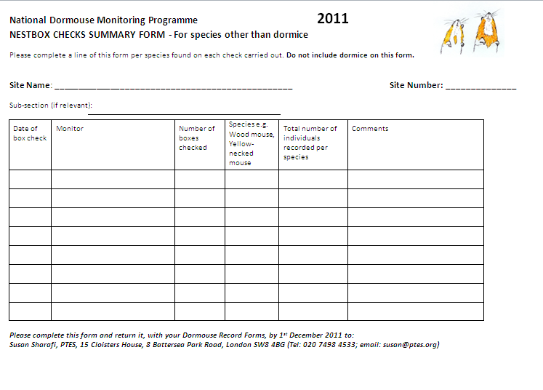

Slide 11
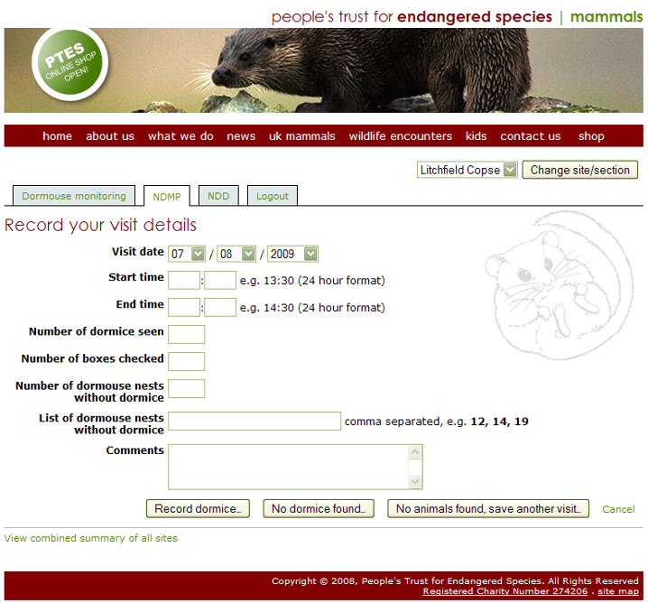

Slide 12
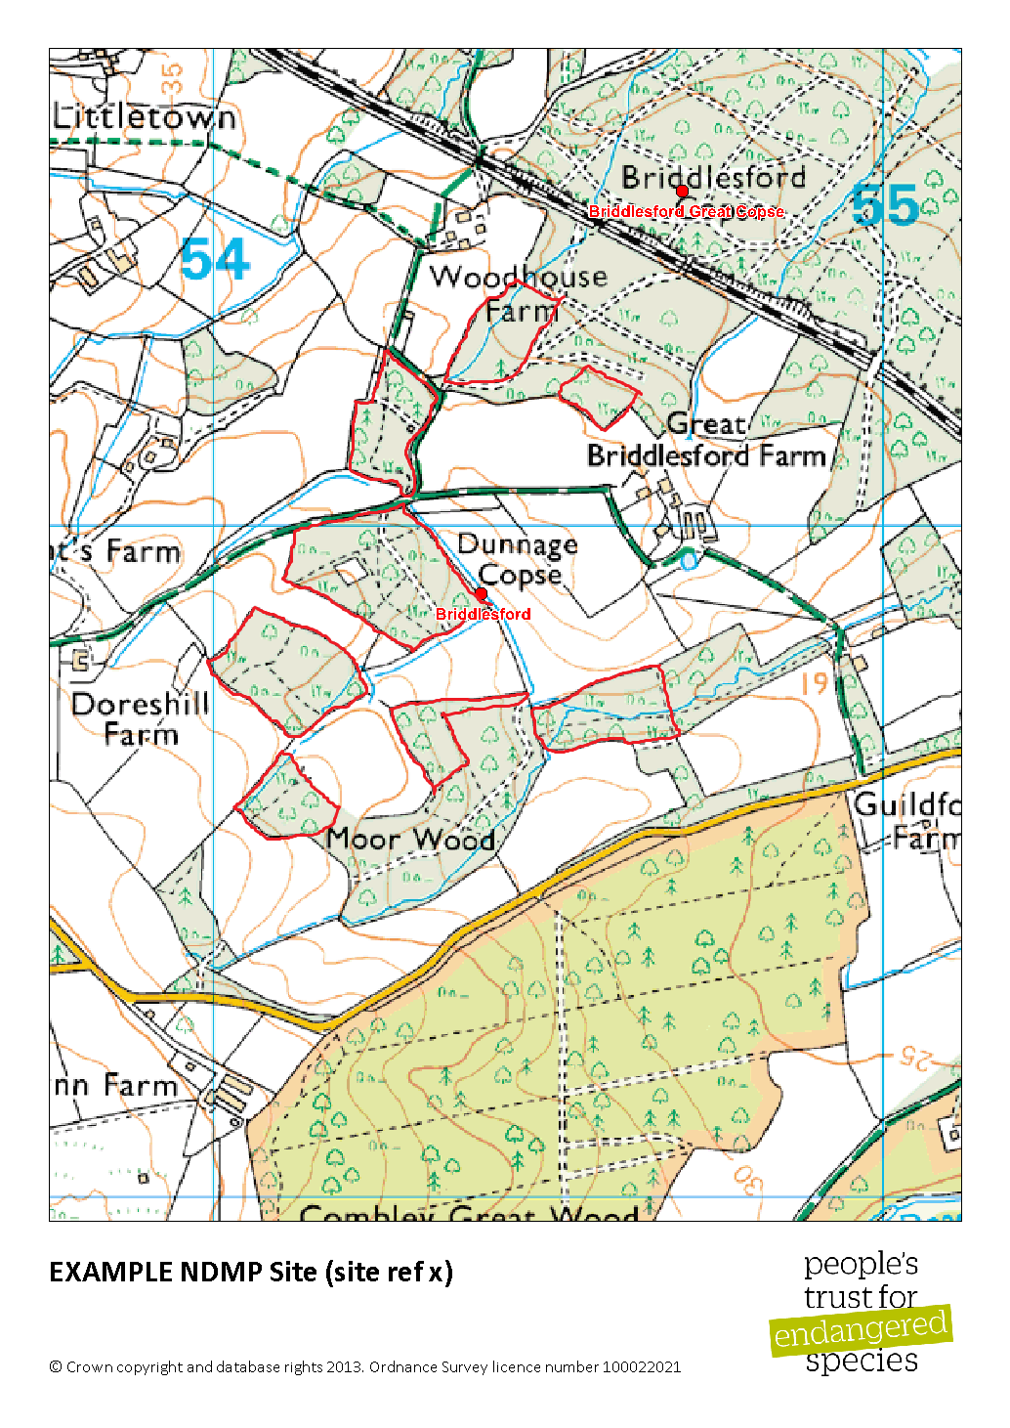
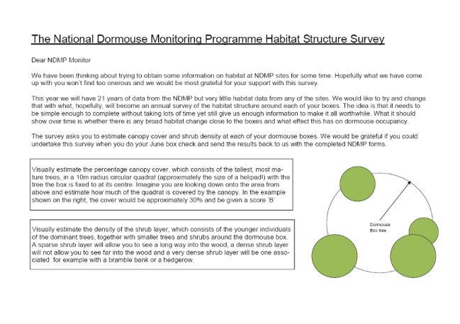
Other forms for the NDMP
New site registration
Woodland owners form
Site boundaries and boxes
Woodland Structure

Slide 13
New site registration
Detail of monitor
Whether prepared to train people

Slide 14
Site boundaries and boxes
Draw on map area where boxes are sited
Confirm number of boxes at site

Slide 15
Dormouse Training Log
Checklist to ensure high standards
Use to support application
Signatories can act as referees but are not obligated to

Slide 16
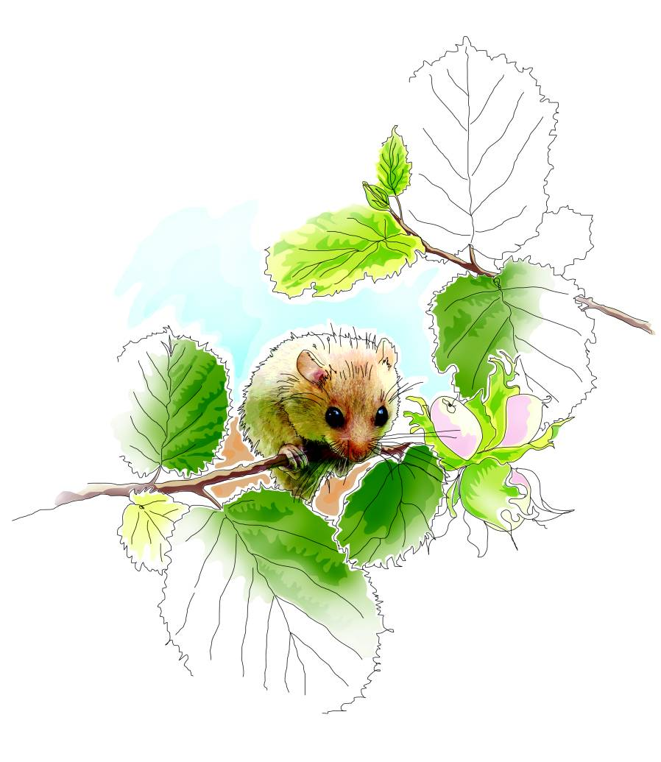
People’s Trust for Endangered Species, 3 Cloisters House, 8 Battersea Park Road, London SW8 4BG
Registered charity no 274206

