Slide 1
This is a sample from the Conservation of the hazel dormouse presentation. You are free to use either the whole presentation, individual slides or content within them. Notes are available for each presentation Please email ian.white@ptes.org for access to all presentations and notes.

Slide 2
Conservation of the hazel dormouse

Slide 3
Dormouse Conservation
Finding Dormice – Survey methods
Dormouse requirements and densities
Problems for the species
Mitigation suggestions
Dormouse re-introductions

Slide 4
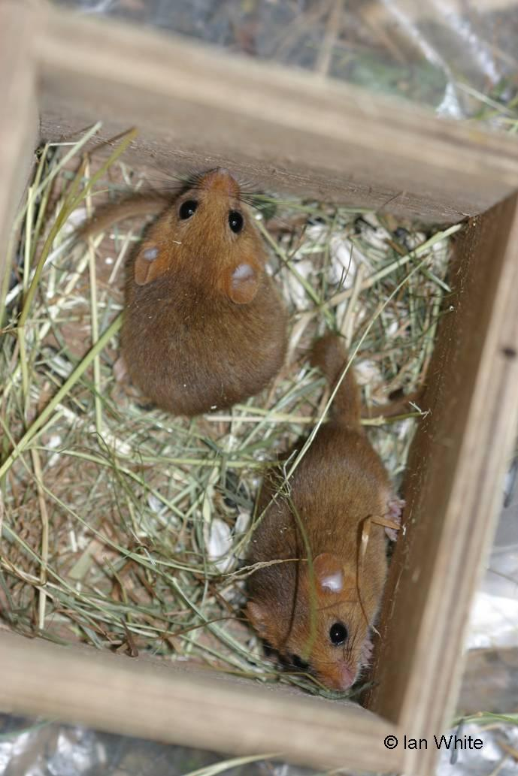
Nest Boxes
Expensive survey method
Best used on vertical stems
Use for long-term monitoring (NDMP)
50 boxes
Grid approx. 20m apart.

Slide 5
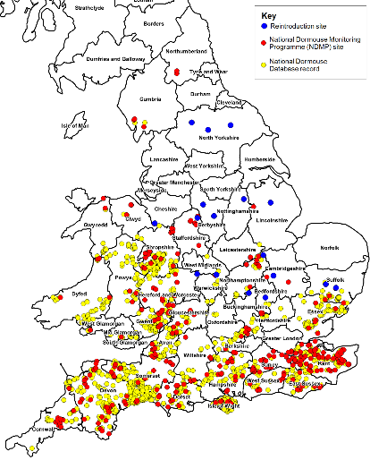
Dormouse surveys - Good practice
Does site fall in known range
Check for existing records (LRC, NBN)
Are dormice known to be present?
Conduct survey
Report presence of dormice to LRC

Slide 6
Where to look for dormouse
Woodland but hazel is not crucial
Conifer wood
Scrub
Hedgerow
Small habitat areas
Roadside/railside verges
Dormice are probably under-recorded
Dormice may be present in any wood or scrub habitat within their range

Slide 7
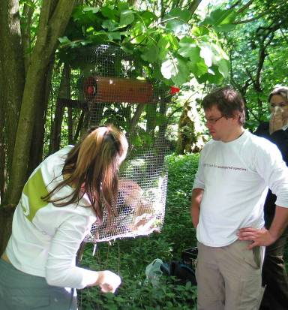
Dormouse reintroductions
Why reintroductions?
Substitute for natural recolonisation
Restore lost range
Stimulate conservation effort
Focus for landscape restoration

Slide 8
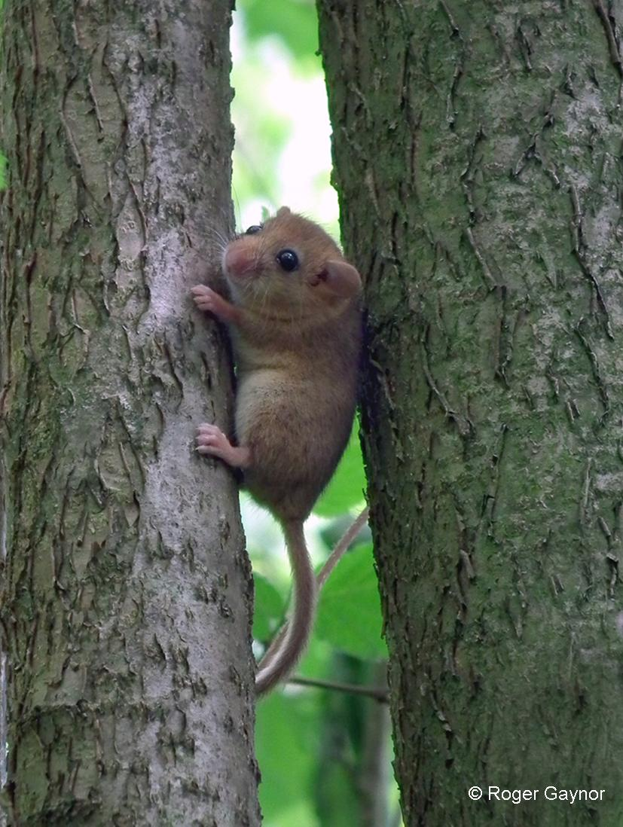
Why are dormice good?
Key species
Plant diversity
Shrub structure
Woodlands
Hedgerows
Scrub
Responsibility
What’s good for dormice is good for many other species

Slide 9
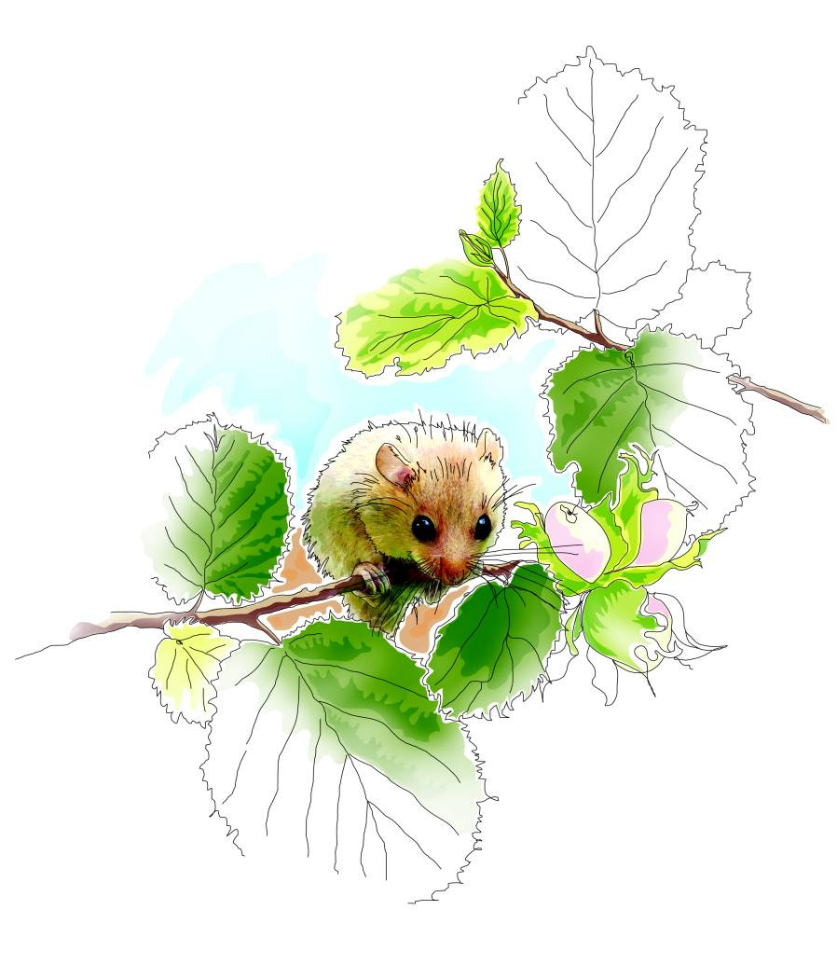
People’s Trust for Endangered Species, 3 Cloisters House, 8 Battersea Park Road, London SW8 4BG
Registered charity no 274206

