Slide 1
Mammal Detectives
Case no. ukmam-006-4533
Notes:
Welcome to the mammal detectives workshop. Today you are to become temporary members of the Woodland Crime Scene Investigation Unit. Your task will be to learn enough mammal detecting skills to solve a crime, and pick out the guilty mammal from a line up of five suspects. But first let me introduce the crime itself…

Slide 2
The crime…

Slide 3
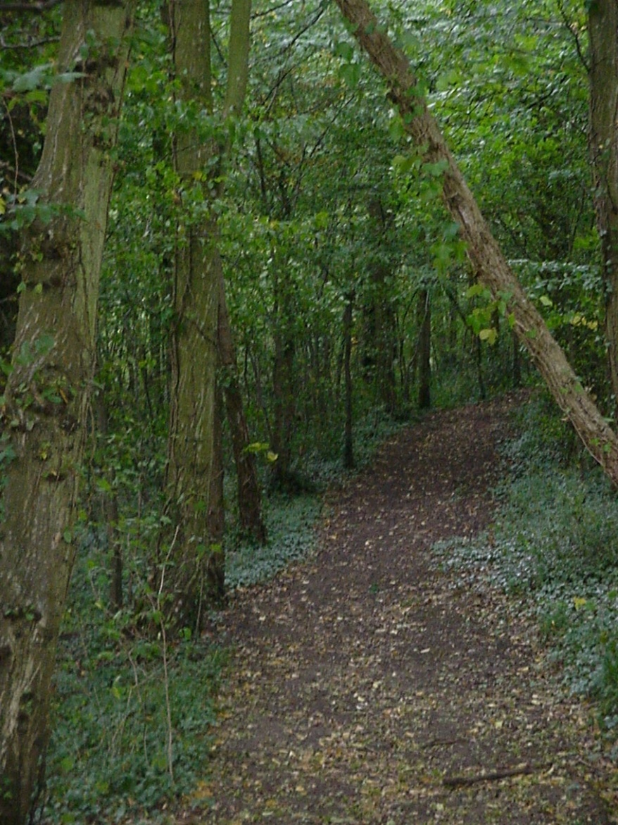
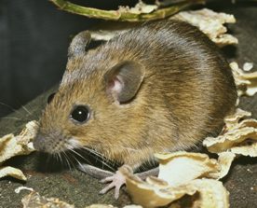
Victim: Yellow necked mouse (Apodemus flavicollis)
Crime: Winter store raided and hazelnuts stolen
Location: Tree hollow, Briddlesford Woods, United Kingdom
Habitat: Woodland
Date: 25th August 2009
Time: 12:02am
Notes:
On the 25th August 2009, Mr Flavicollis, the yellow-necked mouse had a large quantity of his autumn store of hazelnuts stolen. He had expended a large amount of time and energy gathering this store, which he hoped would see him through the cold winter months ahead. Mr Flavicollis is not amused. He would like his store of nuts returned, and the mammal responsible brought to justice. Luckily, the Woodland Police were on the scene quickly, and have arrested five suspects acting suspiciously in the area. Evidence, both physical and circumstantial has been gathered and is ready to be analysed. Your task is to examine the evidence and charge one of the five suspects before this session is over. So now to present the suspects…

Slide 4
The suspects…

Slide 5
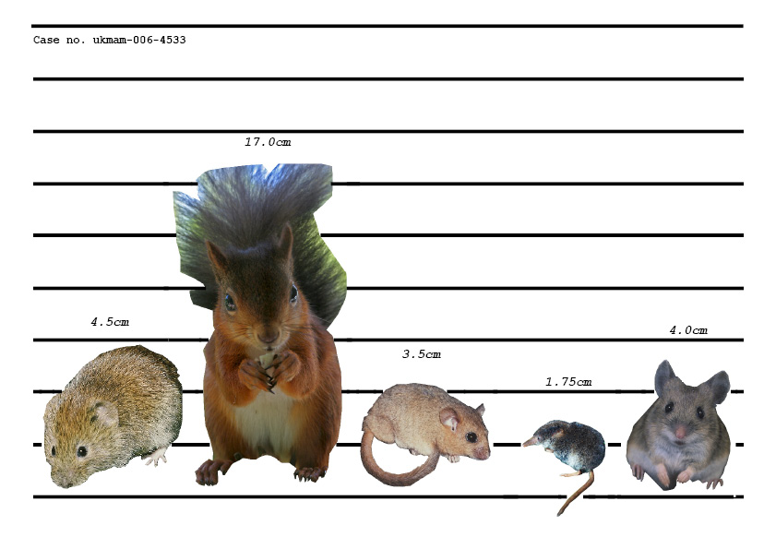
Notes:
(From left to right. Ask the children if they recognise any of them.) Here are our suspects- the bank vole, the red squirrel, the common or hazel dormouse- although they are actually very uncommon- , the pygmy shrew and the wood mouse. Who has a guilty face? Before we accuse anyone we have to look at all the evidence to find clues as to who may have committed this crime.

Slide 6
Circumstantial evidence
Habitat
Behaviour
Diet
Notes:
Our first set of evidence, exhibit A, is based on facts that may allow us to find out if that mammal is guilty without physical evidence. Here are some suspect profiles that contain information collected by the woodland police after interviewing the mammals . Let’s read through them and see if we can find some clues as to who may have stolen the hazelnuts and why. Remember we are looking for someone who would have a reason or motive to commit the crime, who would have the ability to commit the crime and would have likely to be near the tree hollow when the crime took place. (Remind the children the crime took place in the middle of the night, up in a tree hollow).

Slide 7
Notes:
(Depending on time and ability you may wish to read all or part of each profile. Key pieces of evidence to point out are : range and habitat, what time of day the mammal is active, ability to look for food and diet. You will need to point out the Isle of Wight where the crime took place.)

Slide 8
Notes:
(Depending on time and ability you may wish to read all or part of each profile. Key pieces of evidence to point out are : range and habitat, what time of day the mammal is active, ability to look for food, habitat and diet.)

Slide 9
Notes:
(Depending on time and ability you may wish to read all or part of each profile. Key pieces of evidence to point out are : range and habitat, what time of day the mammal is active, ability to look for food, habitat and diet.)

Slide 10
Notes:
(Depending on time and ability you may wish to read all or part of each profile. Key pieces of evidence to point out are : range and habitat, what time of day the mammal is active, ability to look for food, habitat and diet.)

Slide 11
Notes:
(Depending on time and ability you may wish to read all or part of each profile. Key pieces of evidence to point out are : range and habitat, what time of day the mammal is active, ability to look for food, habitat and diet.)

Slide 12
Physical Evidence
Teeth markings
Leaves
Notes:
As we have several suspects still in the running we need to look at some physical evidence to back up the circumstantial evidence to lead us to the guilty mammal. This will require excellent identification skills to examine evidence found by the police at the scene of the crime.

Slide 13
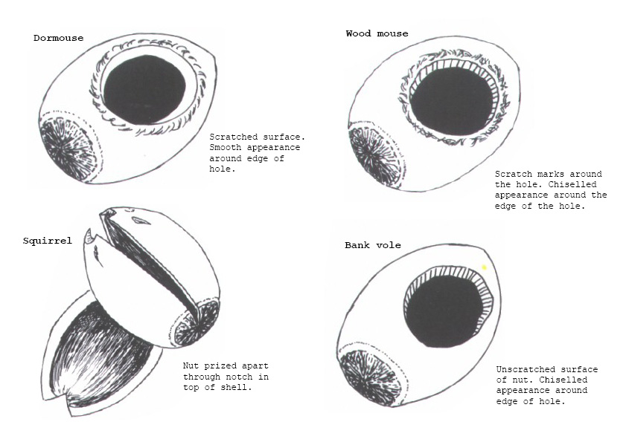
Notes:
(Hand out nuts/photo of nut to share within the groups, and magnifiers if available) Here we have exhibit B- some of Mr Flavicollis’ hazel nuts that were left behind in his hole. Stupidly the guilty mammal couldn’t resist a nibble of a nut or two and left behind the shells. These shells have teeth marks on them and you need to match them up to one of these pictures. (ANSWER:DORMOUSE).

Slide 14
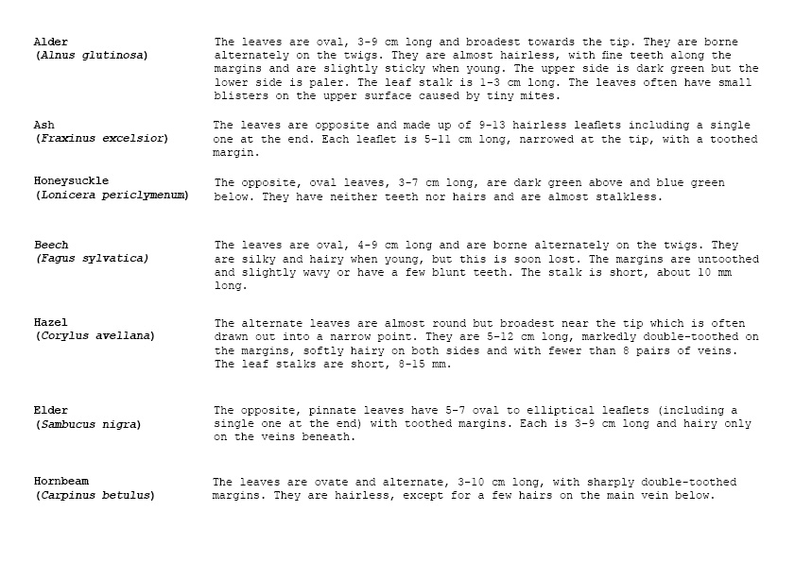
Notes:
Before we accuse anyone, we have our last piece of evidence, exhibit C. (Hand out the leaves and keys to share within groups). These are a few leaves left behind in Mr. Flavicolllis’ hollow by the perpetrator. You need to identify what type of leaves they are and then ,using the circumstantial evidence, who would have left them behind. You have a short description here and some photos to help you identify the leaves. You must look very closely at the shape of the leaves, the size, the texture etc. (ANSWER:HONEYSUCKLE. Look back at the suspect profiles to pick out of the information who may like to eat honeysuckle or use it to build a home. ANSWER:DORMOUSE)

Slide 15
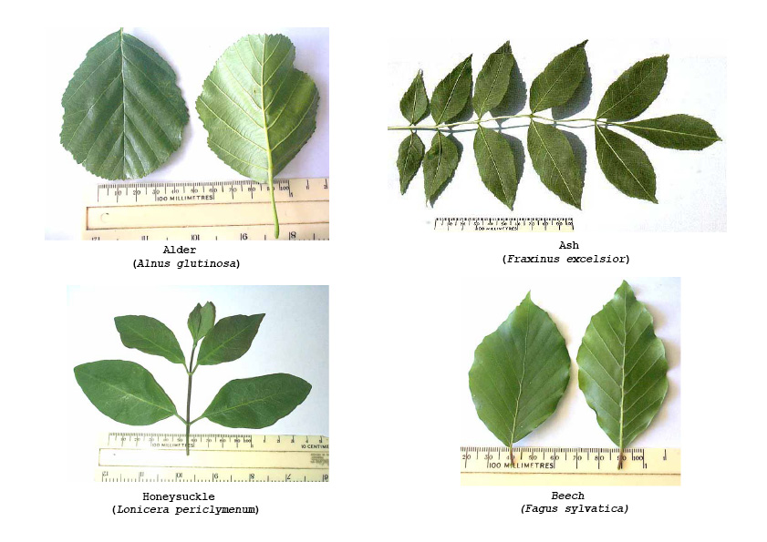

Slide 16
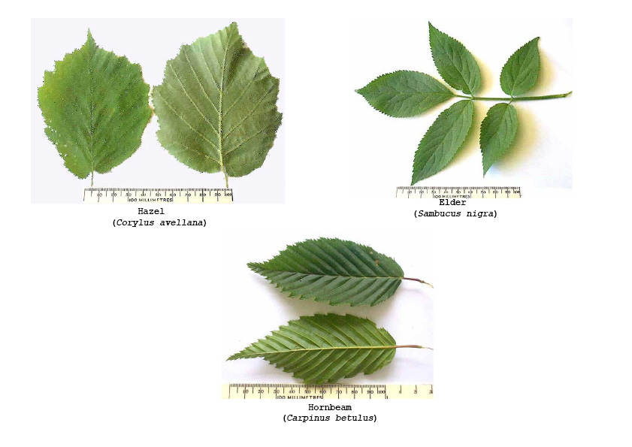

Slide 17
Notes:
(Review the evidence for each suspect as a class and ask each group to decide amongst themselves who they think stole the hazel nuts. Take a class vote as to who they think is guilty. ANSWER:DORMOUSE). Were you correct? Let’s find out because shortly after the woodland police arrested our suspects, one of them confessed….

Slide 18
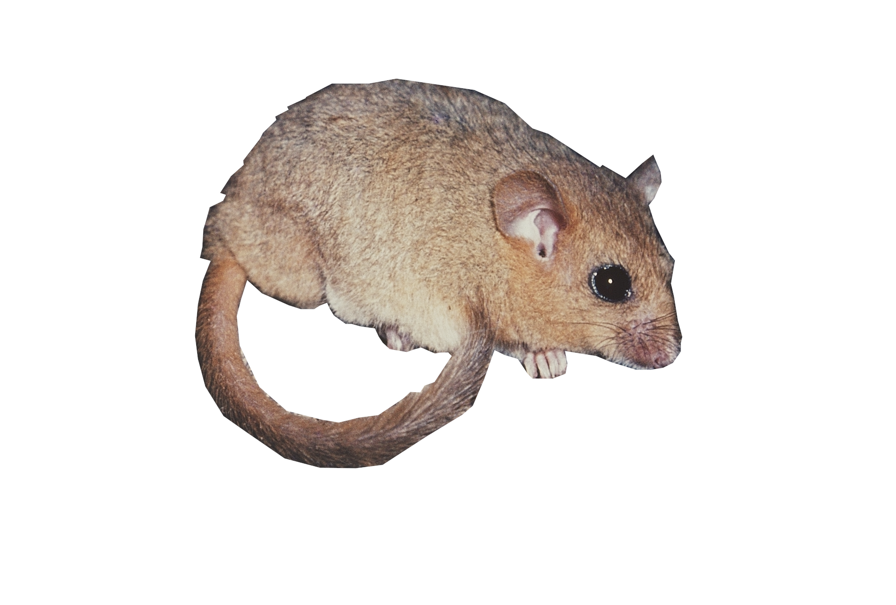
Notes:
This is our culprit , Honey the common or hazel dormouse. Honey is nocturnal. Under the cover of night she used her excellent climbing skills to scale the tree where Mr Flavicollis had his winter store. Having taken the nuts, Honey could not resist eating one or two of them before she hurried away. She also trailed some honeysuckle nesting material behind her. Honey confessed to the police and apologised to Mr Flavicollis. He was very understanding as he realised Honey needed the hazel nuts to fatten her up ready for her winter hibernation. Being a yellow necked mouse, Mr Flavicollis does not hibernate and can find other food over the winter so let Honey keep some of his hazel nuts. THE END.

